Slide 1
EMBRACING AUTOMATION IN REPUBLIC BANK
NAME: STEPHEN KARIM DATE: SEPTEMBER - 2024

Slide 2
Republic Bank's Strategic Plan
Republic Bank's strategic focus for the near future is centered around three key pillars:
DIGITIZATION
CUSTOMER-CENTRIC APPROACH
SUSTAINABLE GROWTH
"Driving innovation through enhanced digital banking platforms such as RepublicOnline and RepublicMobile, enabling seamless, user-friendly experiences for customers.“
"We aim to further enhance this innovation by digitizing our backend processes, allowing the next pillar to shine even more brightly."
"Empowering our employees to focus on meaningful customer interactions by automating repetitive tasks. This enables more personalized and responsive service while improving operational efficiency.“
"By streamlining processes, we build the foundation for sustainable growth, enhancing our ability to meet evolving customer needs."
"Fostering long-term profitability and resilience by leveraging a diverse asset portfolio, while aligning with sustainability initiatives."
"Republic Bank’s innovation and focus on customers reinforce its leadership across the Caribbean, South America, and beyond. Investing in people and technology drives responsible growth and community impact."

Slide 3

RECOVERIES EDITION
Challenges and opportunities
Automated Process Overview
Human Touch Interaction
Recoveries Flow Overview
Enhancing Flows
Loading A19A Database
Loading Active Follow-ups
Cautions
Folio Creation for AV Knowles (TBA)
Implementation strategy cycle
Results From Caution Search
Requirements / Enhancements
Recommendation / Conclusion
Post AV Knowles account processing (TBA)
BNK Balancing (TBA)
Quarterly Returns (TBA)
Sending Letters (TBA)

Slide 4
CHALLENGES & OPPORTUNITIES
CHALLENGES FACED
OPPORTUNITIES PRESENTED
POTENTIAL BENEFITS
Transitioning from manual processes to automation in Recoveries presents challenges like employee resistance and tech adaptation. Fears of job loss, misperceptions of automation's benefits, and data security concerns need addressing. Clear communication and structured change management are vital for smooth transitions.
Automating repetitive tasks can improve efficiency, reduce errors, and shorten processing times. This shift allows staff to focus on high-value tasks, enhancing customer relationships and managing complex recovery cases. Ultimately, these changes will elevate customer satisfaction, boost productivity, and trim operational costs, offering a competitive advantage in finance.
Automation leads to consistent workflows and faster turnaround times, driving significant cost savings. Enhanced productivity and optimized resources create a competitive edge while improving customer service quality.

Slide 5

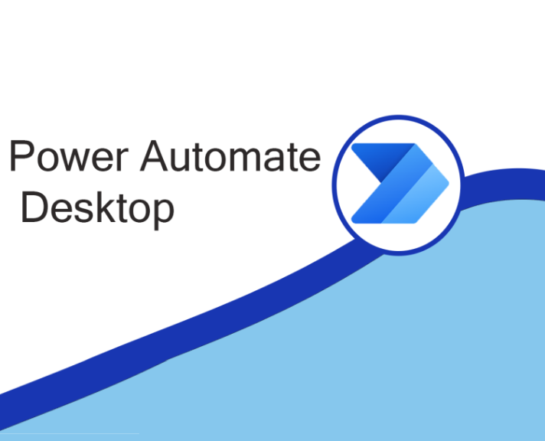
AUTOMATED PROCESS OVERVIEW
PROCESS EFFICIENCY
Through automation, manual processes like email monitoring, data entry, and financial balancing are performed quickly and accurately, which results in streamlined workflows and optimized resource allocation.
AUTOMATION TOOLS
Leveraging tools like Power Automate Desktop and Python scripts, Republic Bank can seamlessly automate data processing tasks within its existing infrastructure. Power Automate Desktop, with its deep integration into Microsoft Office 365, allows us to automate repetitive tasks like data extraction, report generation, and cross-platform data retrieval. By using Python alongside Power Automate, we are able to efficiently process, validate, and transform large datasets, all while minimizing the risk of manual errors.

Slide 6

HUMAN TOUCH INTEGRATION
Personalized services and tailored solutions are essential for long-term success in funds recovery. Thoroughly exploring every opportunity reduces missed chances, leading to greater recovery success.
BALANCING AUTOMATION WITH HUMAN INTERACTION
While automation streamlines processes, the human element in customer interactions is crucial. By automating repetitive tasks like data entry and report generation, employees can focus on high-value activities requiring human judgment—such as responding to customer issues, providing personalized service, and fostering meaningful client relationships. This balanced strategy enhances operational efficiency without compromising customer satisfaction. Automation supports the human touch by alleviating back-end workload and improving front-end service.

Slide 7
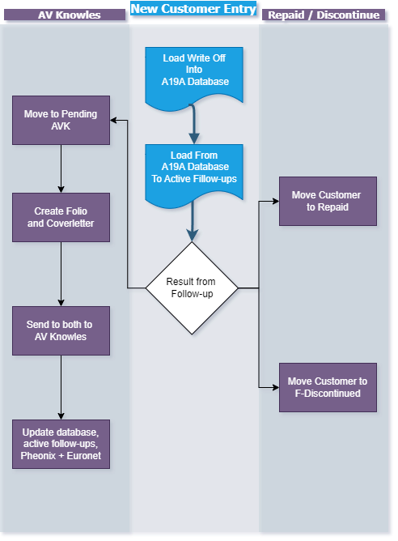
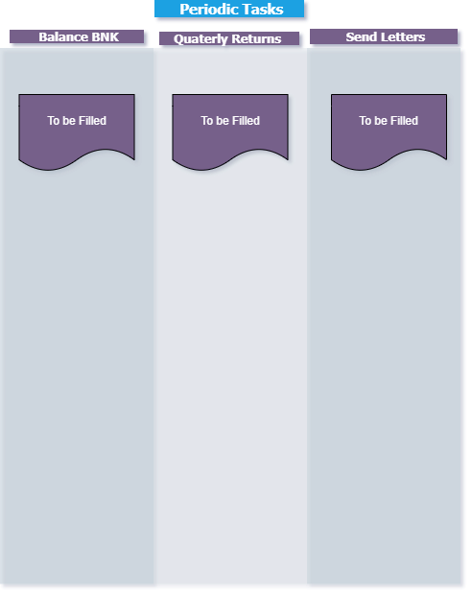
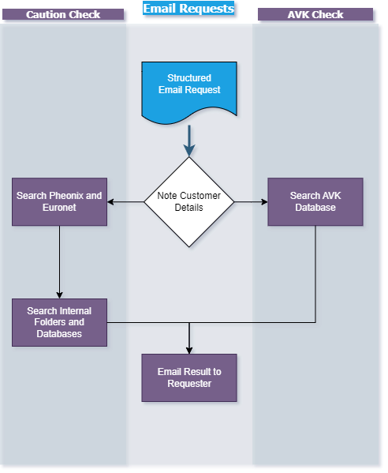
RECOVERIES FLOWS OVERVIEW

Slide 8
ENHANCING FLOWS A19A DATABASE LOADING:
DATA SOURCES AND RETRIEVAL
DATABASE STORAGE ON SHAREPOINT
FULLY AUTOMATED, HIGH-PRECISION DATA LOADING
The A19A Database pulls data from locally stored Excel sheets and applications like Phoenix and Euronet, focusing on new customer recoveries.
Power Automate Desktop’s Robotic Process Automation (RPA), which mimics human actions on a computer, is employed to extract data directly from Phoenix and Euronet.
For the Excel files, Python scripts integrated into Power Automate efficiently search and extract the necessary data. This method ensures all relevant information is gathered seamlessly and accurately from both applications and local files.
While data for the A19A Database is sourced locally, the database itself is securely stored on SharePoint, providing centralized access and collaboration.
To ensure seamless integration, Power Automate Desktop works in conjunction with Power Automate’s cloud capabilities. This combination automates the transfer of data from local sources to the cloud-based SharePoint database, ensuring all entries are consistently updated.
This setup not only maintains data integrity but also enables real-time updates.
Leveraging Power Automate Desktop’s RPA and Python, the A19A Database is populated with precision and efficiency.
Automating data extraction from Phoenix, Euronet, and Excel files eliminates manual intervention, reducing error risks. The process includes detailed data validation, ensuring only accurate information is uploaded to the SharePoint-hosted database.
This unmanned solution saves time and enhances the reliability of data, supporting effective recovery operations.

Slide 9
ENHANCING FLOWS ACTIVE FOLLOW-UPS LOADING:
DATA SOURCES AND RETRIEVAL
COMPLETE DATA WITHOUT REPETITION AND ALSO FULLY AUTOMATED
Building on the comprehensive data from the A19A Database, this step focuses on creating individual customer sheets for active follow-ups.
Each sheet is generated automatically, pulling accurate data from the A19A Database and sorting it by the customer's last name.
This approach ensures that all relevant information is systematically organized into files dedicated to each letter of the alphabet, streamlining the follow-up process.
Following the systematic organization from the A19A Database, Power Automate Online ensures precise, consistent population of customer active follow-up sheets. This step automates necessary data repetition across multiple sheets with high accuracy, avoiding manual errors like misplacing data or mistyping, which could compromise data integrity.
Predefined rules guide the accurate input of customer information based on last names, keeping data consistent and reliable. The automated system continuously updates customer sheets, reflecting any changes from the A19A Database in real-time.
This ensures follow-up sheets are current and accurate, providing a solid foundation for recovery efforts. The cloud-based setup facilitates seamless access and collaboration, ensuring team members have up-to-date information without risking discrepancies.

Slide 10
ENHANCING FLOWS CAUTIONS:
AUTOMATED EMAIL MONITORING
GETTING AND USING CUSTOMER DATA FOR SEARCHING INTERNAL FILES
FORMATTING DATA AND SENDING RESULTS ACCURATELY
Power Automate can monitor your email in real-time or on a schedule, allowing you to trigger flows based on specific email events. Whether a new email arrives, an email is flagged, or one is sent, you can configure Power Automate to initiate flows that perform tasks like categorizing messages, forwarding them to certain folders, or starting more complex workflows.
This enables you to automate email management, ensuring that important emails are addressed promptly and follow your predefined rules.
Power Automate Desktop paired with Python provides a robust solution for two-fold searches using customer data. First, automate searches in specialized applications like Phoenix and Euronet to extract pertinent data or transaction details.
Then, utilize Python scripts to scan internal resources, such as Excel databases and folder directories, to identify matching records or related documents.
This cohesive approach optimizes the entire workflow, from collecting customer data to retrieving comprehensive information across various platforms, ensuring accurate and thorough results.
Furthermore, the integration of Power Automate Desktop with Python allows for efficient data formatting and sending after thorough searches across platforms like Phoenix and Euronet, along with internal files.
Python ensures correct data processing and formatting for reports or standardized documents. Once ready, Power Automate distributes the results to the correct recipients or saves them in designated locations, streamlining the workflow for reliability and automation.

Slide 11
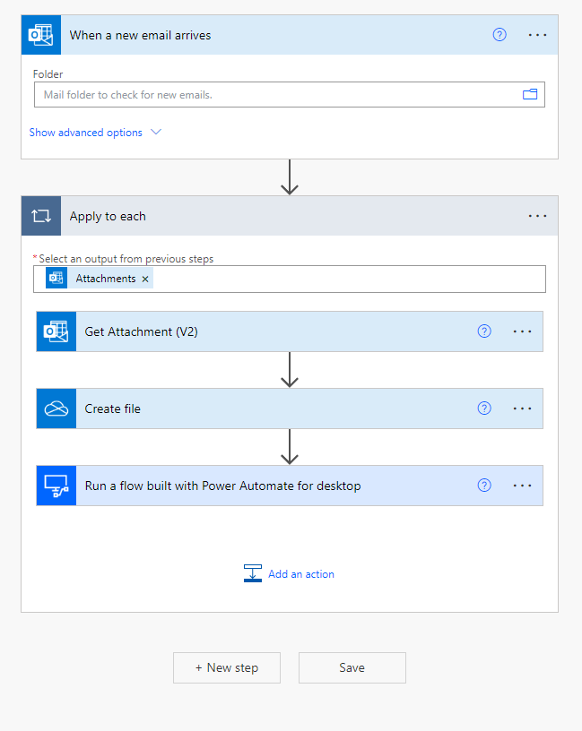
EMBRACING AUTOMATION IN REPUBLIC BANK
CAUTION SEARCH
Power Automate Online trigger

Slide 12
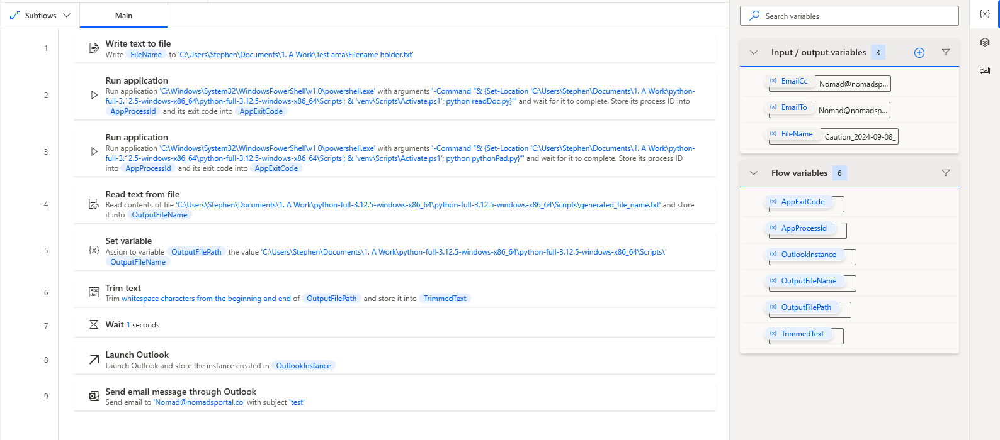
CAUTION SEARCH
Power Automate Desktop Flow
EMBRACING AUTOMATION IN REPUBLIC BANK

Slide 13
CAUTION SEARCH: SEARCH TEST RESULTS
FILE NAME | Sheets | Rows per Sheet | Columns per sheet | Cells Searched | Runtime
large_test_file_1.xlsx | 3 | 100,000 / 200,000 / 300,000 | 50 | 30,000,000 | 101.26 s
large_test_file_2.xlsx | 1 | 200,000 | 50 | 10,000,000 | 34.13 s
large_test_file_3.xlsx | 1 | 300,000 | 50 | 15,000,000 | 51.43 s
EMBRACING AUTOMATION IN REPUBLIC BANK
Dataset Summary
Performance Metrics
Total Files Processed: 3
Total Sheets Processed: 5
Total Rows Processed: 1,100,000
Total Columns Processed per Sheet: 50
Total Cells Searched: 55,000,000
Total Runtime: 101.87 seconds
Parallel Processing: Enabled

Slide 14
CAUTION SEARCH
Script Features
EMBRACING AUTOMATION IN REPUBLIC BANK
Optimized Search: The script searches specific terms across entire rows and leverages parallel processing for faster performance.
Flexibility: Allows for customized search terms per sheet and dynamic header identification.
Result Accuracy: Ensures accurate matches by requiring at least two distinct search terms to be present in any row.

Slide 15
CAUTION SEARCH
Test Computer Specifications
EMBRACING AUTOMATION IN REPUBLIC BANK
Processor: 13th Gen Intel Core i5-13600KF 3.50
Memory: 16GB DDR5 RAM
Storage: Micron M600 MTFDDAK1T0MBF (1TB SSD, high-performance storage with fast read/write speeds)
Graphics Card: NVIDIA GeForce GTX 3070 (8GB GDDR6, supports high-resolution gaming and GPU-intensive tasks)
Operating System: Windows 10 Pro
Cooling System: Mid-range air cooling case with a CPU cooling fan

Slide 16
CAUTION SEARCH
Performance Insights
EMBRACING AUTOMATION IN REPUBLIC BANK
Efficiency:
The script efficiently processes large datasets, demonstrating a runtime of just over 100 seconds for more than a million rows and 55 million cells.
Resource Utilization:
By using parallel processing, the script maximizes CPU utilization, significantly reducing runtime.
Scalability:
The script's performance scales well with larger datasets, ensuring consistent processing times across different file sizes.
Memory and CPU Usage:
The script effectively uses available RAM and CPU cores, with a significant impact observed from the high-end processor and DDR5 RAM.

Slide 17
IMPLEMENTATION STRATEGY CYCLE FOR EACH FLOW
PHASE | ACTIONS | GOALS | TIMELINE
Phase 1: Cautions | Automate loading and monitoring of caution entries.. | Improve accuracy and real-time updates on caution statuses. | 3-5 Days
Phase 2: Database Management | Automate the A19A Database and related follow-ups. | Ensure faster and more accurate data entry and updates. | 3-5 Days
Phase 3: Follow-Ups | Implement a better tracking system for active follow-ups to avoid lapses. | Enhance customer interaction and minimize overdue follow-ups. | 3-5 Days
Phase 4: AVKnowles Folios | Automate the generation of Folios and Cover Letters for AVKnowles | Improve accuracy and complete data for debt collectors | 3-5 Days
Phase 5: Supporting Flows | Automate processes like generating Letters or updating records | Fill any gaps in manual work that can be automated | 1 - 2 Weeks
Phase 6: Money Transfers | Automate critical processes such as BNK Balancing and Quarterly Returns | Improve financial reporting and control over cash flow processes. | 2 - 4 Weeks
Phase 7: Continuous Monitoring | Optimize and monitor the automation processes and gather feedback. | Ensure long-term efficiency and adaptability. | Continuous
EMBRACING AUTOMATION IN REPUBLIC BANK

Slide 18
REQUIREMENTS / ENHANCMENTS
REQUIREMENTS
Dedicated computer
Admin Access
Office 365 / Power Automate online
Premium Power Automate + Attended RPA License (Currently $15 USD monthly)
ENHANCEMENTS
Powerful multicore processor (computer upgrade)
Ram 16-32gb (computer upgrade)
Move shared drives to same computer
Premium Unattended Power Automate License (Currently $150 USD monthly)
EMBRACING AUTOMATION IN REPUBLIC BANK

Slide 19

GPT & Automation
Advantages of GPT-like Tools
Leveraging tools like GPT (Generative Pre-trained Transformer) significantly enhances automation in various sectors. GPT aids in generating content, code, and responses, increasing efficiency while reducing manual tasks. By automating repetitive processes, GPT allows human resources to focus on higher-value endeavors. Notably, most of this presentation was crafted using GPT, highlighting its strengths in content generation and automation. This technology not only streamlined the process but also ensured the delivery of engaging and informative material. Additionally, GPT enhances decision-making by analyzing data and providing actionable insights, maintaining consistent quality through its learning capabilities. Furthermore, the GPT API personalizes interactions, boosting customer satisfaction and the overall user experience.

Slide 20

Recommendations
Power Automate Flows and Python Scripts
To ensure optimal efficiency, data processing tasks should be performed on a dedicated computer, managed by a single user.
This system must be specifically designed for data-intensive operations and have the potential for future upgrades to support multiple processes simultaneously.
Key components like a high-performance processor, sufficient RAM, and SSD storage are crucial for maximizing efficiency and adapting to evolving demands.
While an average computer can manage these tasks at a reasonable speed, a more advanced setup will greatly improve performance and minimize errors.
EMBRACING AUTOMATION IN REPUBLIC BANK

Slide 21

Recommendations
New Role: Automation and Digitalization Officer
As Republic Bank continues to embrace automation, there is a clear need for a dedicated role that focuses on the strategic implementation and scaling of automation technologies. The Automation and Digitalization Officer would be responsible for:
Assessing automation opportunities.
Leading teams to implement digital solutions.
Addressing inefficiencies with advanced tools like Power Automate, coding and AI like GPT.
Ensuring scalable, secure automation systems for long-term growth
Supporting Republic Bank's digital transformation and automation success.
EMBRACING AUTOMATION IN REPUBLIC BANK

Slide 22

Conclusion
The integration of automation tools like Power Automate and Python into Republic Bank’s Recoveries division has proven to be highly effective, streamlining processes, enhancing data accuracy, and significantly reducing manual workloads. By automating essential tasks such as caution searches and database management, this will lay a strong foundation for more efficient and scalable operations.
These technologies have not only boosted productivity but also showcased their capability to manage large datasets with precision. As Republic Bank continues to evolve, these systems will provide the flexibility needed to address increasing data demands and the complexities of future business challenges.
To ensure these advantages are maintained, ongoing investment in advanced hardware and software solutions is crucial. A focus on process optimization, combined with cutting-edge tools, will position Republic Bank to stay ahead of industry trends, ensuring both operational excellence and superior customer satisfaction.
Embracing automation is a pivotal step in the bank’s digital transformation journey, and with strategic leadership from an Automation and Digitalization Officer, Republic Bank is poised to leverage future innovations and secure long-term success.
EMBRACING AUTOMATION IN REPUBLIC BANK

